Slide 1
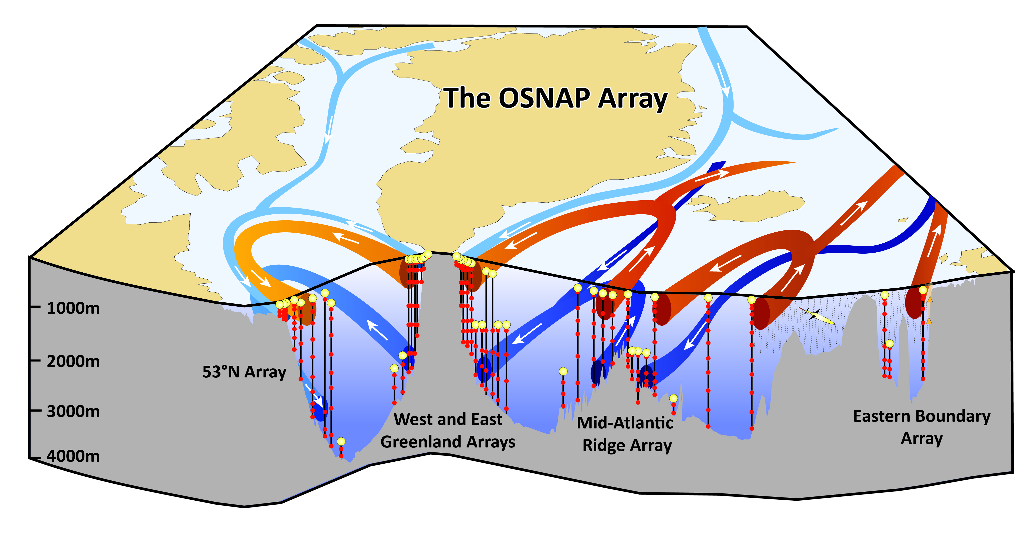
UK OSNAP: Overturning in the Subpolar North Atlantic
Penny Holliday, NOC
“… continuous record of the full-water column, trans-basin fluxes of heat, mass and freshwater in the subpolar North Atlantic…”
Gyre circulation and MOC
MOC response to forcing over range of lats
SPG density and the MOC
Deep layer pathways/mixing
Statistical significance of extreme events in obs
(models, reanalyses, observations)
Observations 2014-2018
Moored instruments, gliders, floats (Argo and RAFOS)
Deployed in 2014, full turnaround in 2016, 2018
First time series results in 2017
UK: DWBC and Eastern Boundary

Slide 2
Hydrographic section in June-July 2014:
a snapshot of the subpolar gyre as the array is deployed
RRS James Clark Ross JR302
King and Holliday
EEL/OSNAP/RAGNARRoC

Slide 3
MOC and fluxes in June-July 2014: seasonal context
Model analysis (FLAME):
Lowest MOC in late summer
Highest MOC in winter
Highest variability in winter
Single section at start of obs period (prelim):
MOC = 20.5 ± 0.5 Sv
Heat flux = 0.40 PW
Freshwater flux = 0.24 Sv
Holliday, Li et al

Slide 4
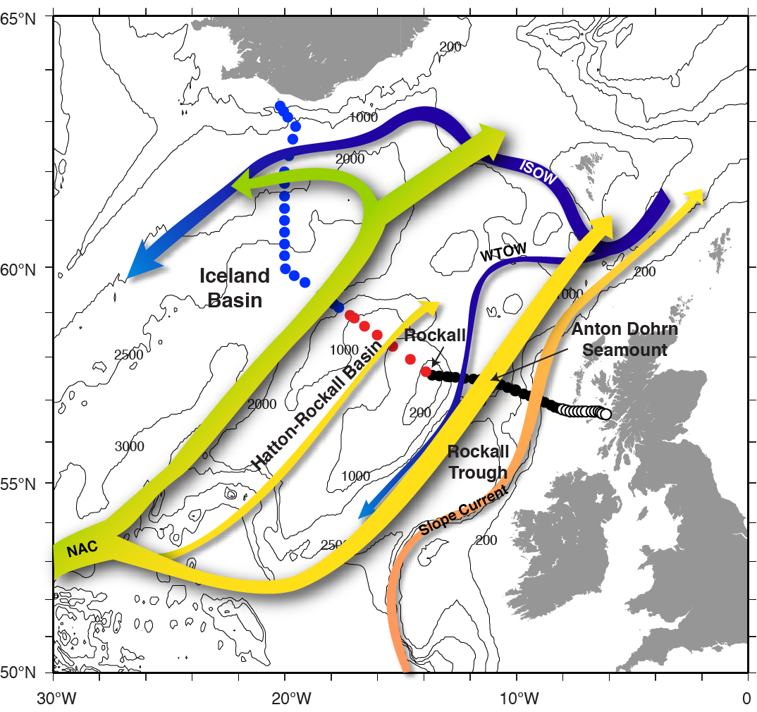
Transport estimates from gliders in the eastern boundary
Holliday et al, 2015. JGR

Slide 5
Transport estimates from gliders in the eastern boundary
1.0 Sv
Geostrophic transport from T/S,
reference velocity from
depth-averaged currents from glider movement.
11 sections Hatton-Rockall Basin
Mean± sd = 0.05 ± 0.09 Sv
Branch of NAC between Hatton Bank and easternmost tall mooring in Iceland Basin
0.0 Sv
-0.2 Sv
Aug 14
Aug 15
Loïc Houpert, SAMS, et al

Slide 6
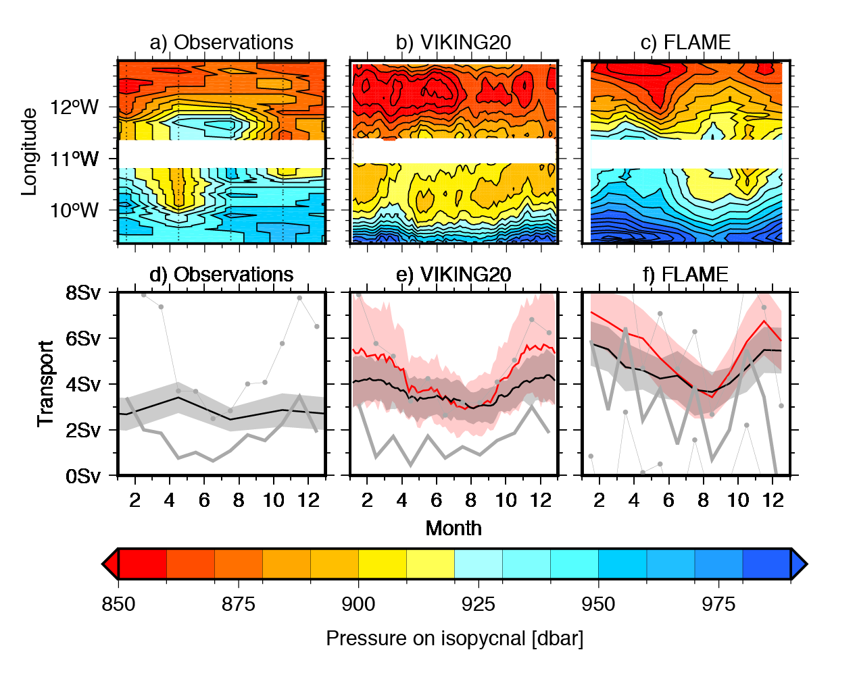
Seasonal cycle of transport from historical & new data, and models
1950-2015 historic, EEL, OSNAP data
in Rockall Trough
Does seasonal anomaly in windstress curl induce seasonal cycle in transport?
Surprisingly, hard to detect in data even where data density is high (EEL and OSNAP)
Models
Seasonal cycles give weakest
geostrophic transport in summer
Strongest transport and highest
variability in winter
BUT mesoscale and interannual variability so high that it masks the seasonal cycle
Pressure on thermocline isopycnals in obs and models
Black lines are geostrophic transports
Red lines are absolute transports
Grey lines are Sverdrup transport from wind stress
(CCMP for obs, relevant forcing for models)
Stefan Gary, SAMS et al

Slide 7
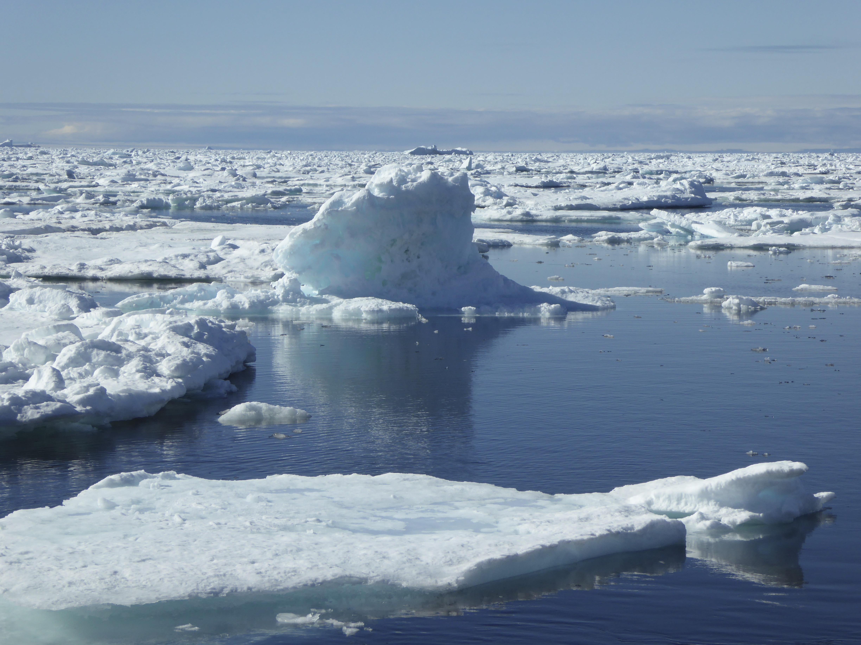
Summary
OSNAP array in water 2014, turnaround 2016, 2018: first array time series in 2017
2014 CTD section estimates fluxes as the array was deployed; model gives seasonal context
First results from glider over Hatton Plateau show low transport, high variability, and that
the moorings miss significant flow in eastern NAC
Transport seasonal cycle in Rockall Trough masked by mesoscale and interannual variability
penny.holliday@noc.ac.uk
@uk_osnap
www.ukosnap.org
ukosnap.wordpress.com

